Slide 1
第3章 故障处理
1 故障模型
2 可靠通信(可靠组播)
3 协定问题(共识算法，拜占庭将军问题)
4 分布式恢复 (检查点和日志；自稳定算法)
参考文献
CDK5, Chapter 2, System Models
CDK5, Chapter 15, Coordination and Agreement
Distributed Systems, An Algorithm Approach, Chapter 17, Self-stabilizing Systems
Notes:
1

Slide 2
1. Failure Model

Slide 3
Failure Model
Terms: fault, error, failure
Fault：指系统的缺陷，有缺陷不一定会出故障
Error：指系统应该的状态与实际状态之间的差异
当系统由于激活了Fault，而进入一个意外的状态，那么出现Error
Failure：指系统行为与其规约不一致
Error未必引起Failure：如果系统抛出的意外(Exception)被捕获，并被容错处理，那么系统的操作仍与规约一致
Fault(错误的原因) → Error(错误的系统状态) → Failure(错误运行后的结果)
Classification of failures：按故障持续的时间分类
瞬态性(Transient)，间歇性(Intermittent)，永久性(Permanent)
Classification of failures：在进程和通信通道上发生故障
遗漏故障(崩溃Crash，故障-停止Fail-Stop；通道遗漏故障Channel-Omission，发送遗漏故障Send-Omission ，接收遗漏故障Receive-Omission)
随机故障(Arbitrary/Byzantine Failure)
时序故障(时钟故障Clock Failure，进程性能故障Process Performance Failure ，通道性能故障Channel Performance Failure)
Notes:
3

Slide 4
Failure Model
故障类型 影响 描述
故障-停止 进程 进程停止并一直停止。其他进程可检测这个状态
崩溃 进程 进程停止并一直停止。其他进程可能不能检测到这
个状态
崩溃 通道 通道断链并一直断链。可能不能检测到这个状态
通道遗漏 通道 插入外发消息缓冲区的消息不能到达另一端的接收
消息缓冲区
发送遗漏 进程 进程完成了发送操作，但消息没有放到它的外发消
息缓冲区
接收遗漏 进程 一个消息已放在进程的接收消息缓冲区，但那个进
程没有接收到它
随机 进程 进程/通道显示出随机行为：它可能在随机时间里发
(拜占庭式) 和 送/传递随机的消息，会有遗漏发生；一个进程可能
通道 停止或者采取不正确的步骤
时钟 进程 进程的本地时钟超过了与实际时间的偏移率的范围
性能 进程 进程超过了两个进程步之间的间隔的范围
性能 通道 消息传递花了比规定的范围更长的时间
Notes:
4

Slide 5
故障的处理：基本手段I
故障检测技术
被动式检测是在程序中的若干位置设置检测点，等待错误征兆的出现
需要提供与程序执行模块相分离的自动错误检测模块
主动式检测是对程序状态主动地进行检查；
利用心跳判断分布式进程失效：只是指出进程p可能失效，并非精确地指出p真正失效了：不可靠的故障检测器
不可靠的故障检测器：eventually weak failure detector (eventually weakly complete, eventually weakly accurate)：这样的故障检测器在通信是可靠的、崩溃进程不超过一半的时候，能在异步系统中达成共识
Notes:
5

Slide 6
故障的处理：基本手段II
容错(故障屏蔽)：利用信息冗余、时间冗余、物理冗余
通过信息冗余，例如，校验和，将通信的随机故障转化为遗漏故障
通过时间冗余，例如，消息重传，事务
通过物理冗余，例如，用多个进程提供一个服务，集群
故障恢复机制
故障恢复包括4个步骤：
故障诊断(fault diagnosis)
故障隔离(fault isolation)
系统重配置(system reconfiguration)
系统重启(system re-initialization)
故障恢复手段：
进程迁移
进程替换
Notes:
6

Slide 7
Dependable Systems
Diversification of concepts
High confidence software(高可信软件)
Trustworthy computing(可信计算)
Software dependability(软件可靠性)
Dependability = reliability + availability + safety + maintainability + security
High confidence = reliability + safety + security + survivability + performance
Trustworthy = reliability + security + privacy + integrity
Notes:
7

Slide 8
Concepts explained
Reliability: a system can run continuously without failure
Availability: a system is ready to be used immediately
Metrics for reliability: MTBF = MTTF+ MTTR
Metrics for availability: MTTF/(MTTF + MTTR) * 100%
MTBF: Mean Time between Failures; MTTF: Mean Time to Failure; MTTR: Mean Time to Repair
Percent Availability | Downtime/Year | Categories
99.5 | 1.8 days | Conventional system
99.9 | 8.8 hours | Available system
99.99 | 52.6 mins | Highly available system
99.999 | 5.3 mins | Fault resilient system
99.9999 | 32 seconds | Fault tolerant system
Notes:
8

Slide 9
Concepts explained
Safety: when a system temporarily fails to operate correctly, nothing catastrophic happens.
Safety with respect to an undesirable property A is the assertion that A evaluates to false for all states S reachable from the original state S0 of the system.
Software safety is a software quality assurance activity that focuses on the identification and assessment of potential hazards that may affect software negatively and cause an entire system to fail.
Maintainability: how easy a failed system can be repaired.
Security: secure the processes and the channels used for their interactions and protect the objects that they encapsulate against unauthorized access.
Notes:
9

Slide 10
软件可靠性建模
目的：预测软件可靠性，估计故障存在的数量、未来的发生率和后果
手段：利用已有的失效数据，根据对软件失效行为的假设，采用一定的数学方法建立软件可靠性模型的过程
已有方法：马尔科夫过程、随机时序分析和人工神经网络等
植入模型：在软件中“植入”已知的错误N_{t}，并计算发现的植入错误数n_{t}与发现的实际错误数(n+n_{t})之比而开发出的模型
Notes:
10

Slide 11
2. Reliable Communication

Slide 12
2 可靠通信
可靠通信用通信的有效性和完整性定义：
有效性(validity, liveness)：在外发消息缓冲区的任何消息最终能被传递到接收消息缓冲区
完整性(integrity, safety)：接收到的消息与发送的消息一致，没有消息被传递两次
对完整性的威胁
通信协议允许重发消息，或不拒绝到达两次的消息
可能有恶意用户插入伪造消息、重放旧的消息或窜改消息
Notes:
12

Slide 13
可靠组播
组播是不可靠的
组播会遭遇遗漏故障。(1)任何一个接收者都可能因为它的缓冲区满了而丢弃消息。(2)从一个组播路由器发送到另一个路由器的数据报也可能丢失
组播路由器会出现故障
组播应用需要可靠组播
举例：复制服务，要求或者所有的服务器或者没有服务器接收到一个操作请求
封闭组/开放组：组播发生在组的成员内/组外的进程也可以组播到它
重叠组：一个进程属于两个组
静态组/动态组：组成员不变/可变
Notes:
13

Slide 14
可靠组播的性质
完整性(Integrity, safety)：一个正确的进程p传递一个消息m至多一次。其中，p ∈ group(m)，m由sender(m)提供
有效性(Validity, liveness)：如果一个正确的进程组播消息m，那么它终将传递m
协定(Agreement, liveness)：如果一个正确的进程传递消息m，那么在group(m)中的其它所有正确的进程终将传递m。
有效性和协定一起得到一个全面的活性要求
协定条件与原子性相关
Notes:
14

Slide 15
System model
Processes communicate reliably over one-to-one channels
Processes may fail only by crashing
The members of a group are known without any change of members
Processes are allowed to belong to several closed groups
multicast(g,m) sends the message m to all members of the group g of processes.
deliver(m) delivers the message m sent by multicast to the calling process
Every message m carries the unique identifier of the process sender(m) that sent it , and the unique destination group identifier group(m)
Notes:
15

Slide 16
Basic multicast primitive B-multicast
B-multicast: a correct process will eventually deliver the message, as long as the mulicaster does not crash
B-deliver : the corresponding basic delivery primitive
The way to implement B-multicast :
To B-multicast(g,m):
for each process p∈g, send(p,m);
//send is a reliable one-to-one operation
On receive(m) at p: B-deliver(m) at p.
Ack-implosion
Notes:
16

Slide 17
Implement reliable multicast R-multicast over B-multicast
On initialization：
Received:={}
For process p to R-multicast message m to group g：
B-multicast(g,m);
//p ∈ g, p is included as a destination
On B-deliver(m) at process q with g=group(m):
If (m ∉ Received)
then
Received := Received ∪ {m}
If(q ≠ p) then B-multicast(g,m); endif
R-deliver m;
endif
Notes:
17

Slide 18
关于协定的证明
协定的定义：如果一个正确的进程传递消息m，那么在group(m)中的其它所有正确的进程终将传递m。
反证：设在group(m)中的一个正确的进程A没有传递m(即：R-deliver m)，那么，这只能是因为它从没B-deliver此消息。而且，也没有其它正确的进程B-deliver此消息(如果有，那么会发B-multicast给A，A就会B-deliver该消息)。因此，没有进程会R-deliver消息m。这个结果与前提“一个正确的进程传递消息m”矛盾。所以，得证。
Notes:
18

Slide 19
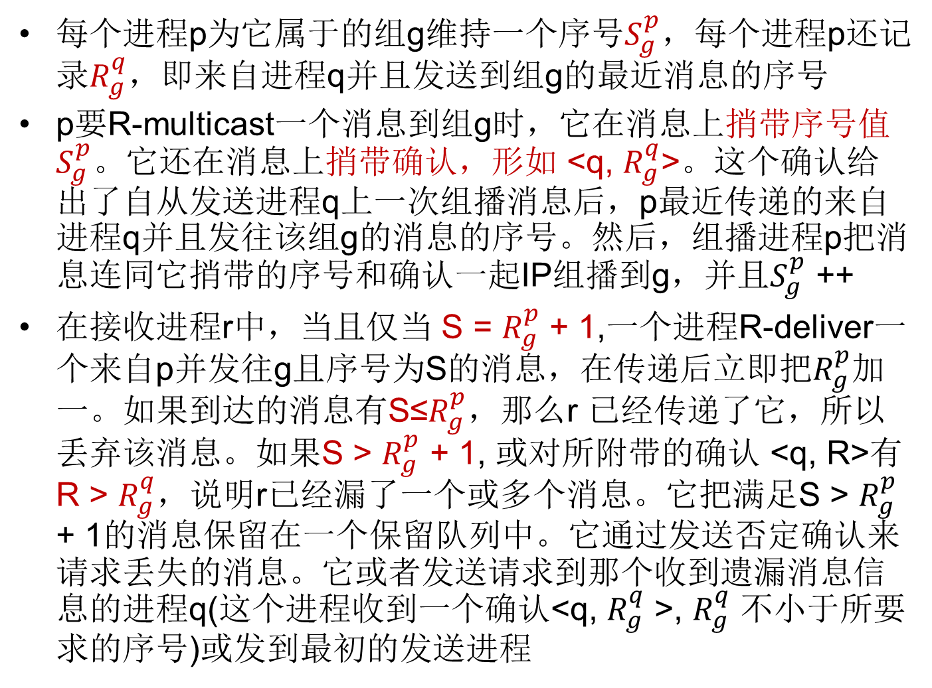
基于IP组播实现可靠组播R-multicast
每个进程p为它属于的组g维持一个序号$S_{g}^{p}$，每个进程p还记录$R_{g}^{q}$，即来自进程q并且发送到组g的最近消息的序号
p要R-multicast一个消息到组g时，它在消息上捎带序号值$S_{g}^{p}$。它还在消息上捎带确认，形如 <q, $R_{g}^{q}$>。这个确认给出了自从发送进程q上一次组播消息后，p最近传递的来自进程q并且发往该组g的消息的序号。然后，组播进程p把消息连同它捎带的序号和确认一起IP组播到g，并且$S_{g}^{p}$ ++
在接收进程r中，当且仅当 S = $R_{g}^{p}$ + 1,一个进程R-deliver一个来自p并发往g且序号为S的消息，在传递后立即把$R_{g}^{p}$加一。如果到达的消息有S≤$R_{g}^{p}$，那么r 已经传递了它，所以丢弃该消息。如果S > $R_{g}^{p}$ + 1, 或对所附带的确认 <q, R>有R > $R_{g}^{q}$，说明r已经漏了一个或多个消息。它把满足S > $R_{g}^{p}$ + 1的消息保留在一个保留队列中。它通过发送否定确认来请求丢失的消息。它或者发送请求到那个收到遗漏消息信息的进程q(这个进程收到一个确认<q, $R_{g}^{q}$ >, $R_{g}^{q}$ 不小于所要求的序号)或发到最初的发送进程
Notes:
19

Slide 20
基于IP组播实现的可靠组播的性质
完整性成立，基于检测副本和IP组播性质(使用校验和来除去损坏的消息)
有效性成立，因为IP组播具有该性质
协定成立，在下列假设下：
每个进程都无限组播消息，这时，该算法能保证检测到丢失的消息
进程无限地保留它们已传递消息的副本
Notes:
20

Slide 21
3. Agreement in Fault Systems

Slide 22
3 Agreement in Fault Systems
Agreement: Agree on a value after one or more of the processes have proposed what that values should be under the circumstance that processes may fail.
Consensus, Byzantine generals and interactive consistency are referred to problems of agreement.
Agreement is needed in many .
Goal: Have all the non-faulty processes reach consensus with in finite number of steps.
Problems
errors in process: crash failure or Byzatine (arbitrary) process failure
Notes:
22

Slide 23
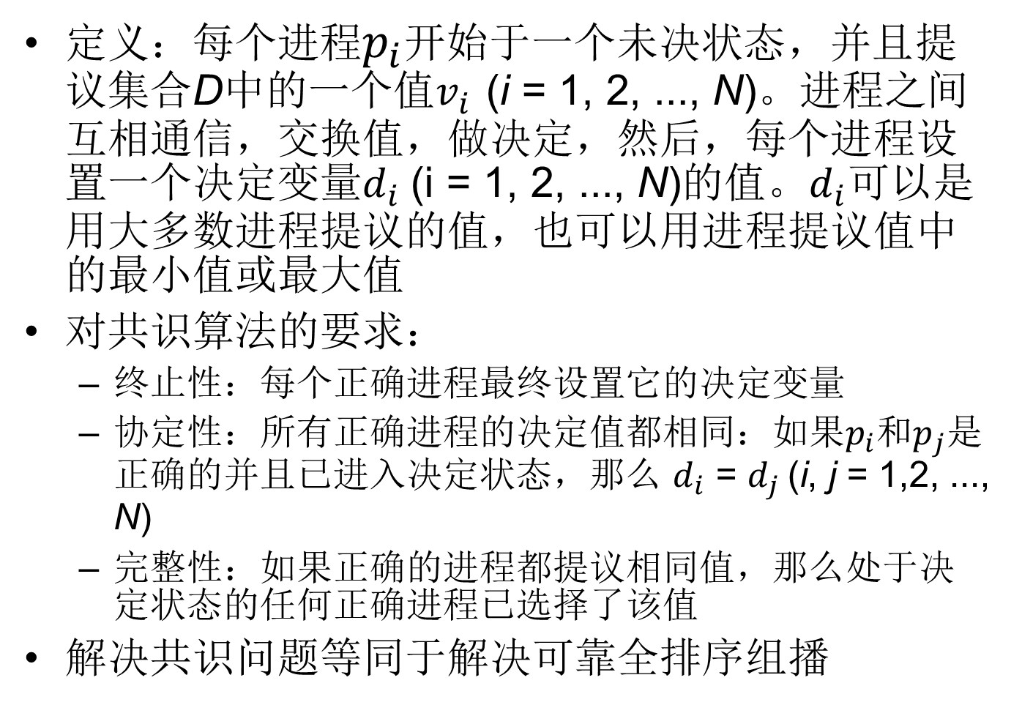
共识问题
定义：每个进程$p_{i}$开始于一个未决状态，并且提议集合D中的一个值$v_{i}$ (i = 1, 2, ..., N)。进程之间互相通信，交换值，做决定，然后，每个进程设置一个决定变量$d_{i}$ (i = 1, 2, ..., N)的值。$d_{i}$可以是用大多数进程提议的值，也可以用进程提议值中的最小值或最大值
对共识算法的要求：
终止性：每个正确进程最终设置它的决定变量
协定性：所有正确进程的决定值都相同：如果$p_{i}$和$p_{j}$是正确的并且已进入决定状态，那么 $d_{i}$ = $d_{j}$ (i, j = 1,2, ..., N)
完整性：如果正确的进程都提议相同值，那么处于决定状态的任何正确进程已选择了该值
解决共识问题等同于解决可靠全排序组播
Notes:
23

Slide 24
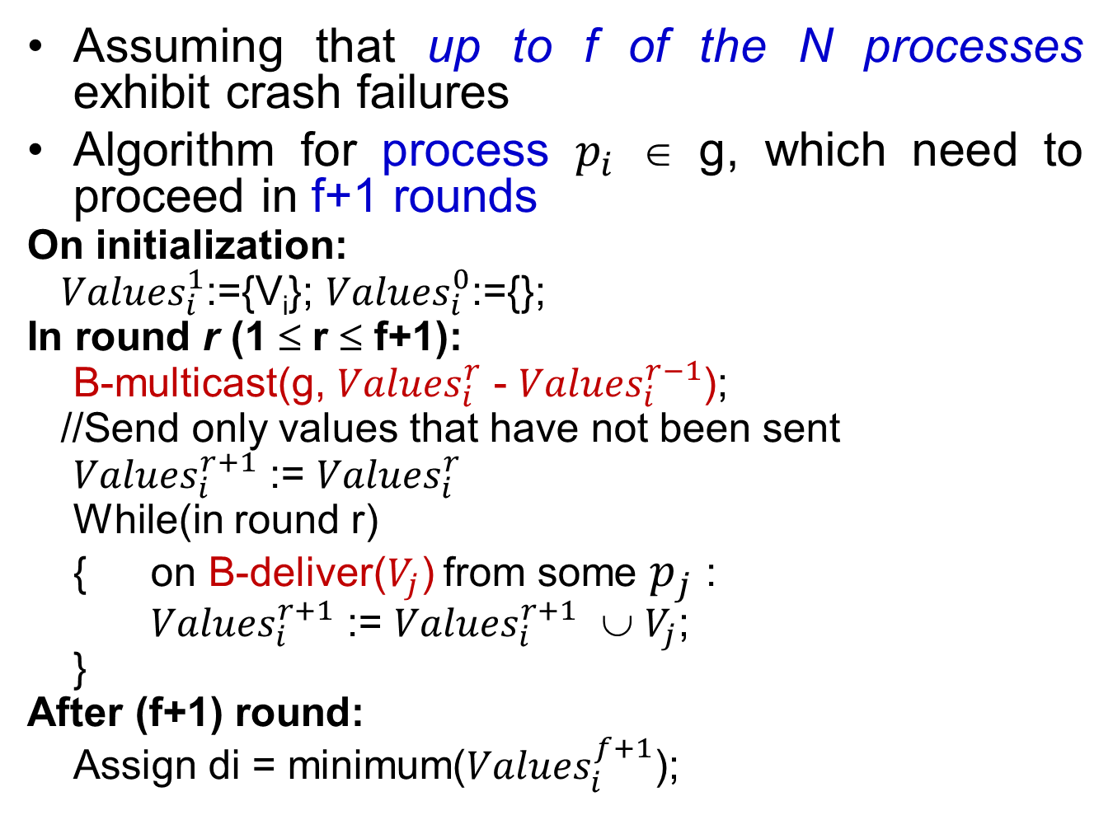
Consensus in a Synchronous System
Assuming that up to f of the N processes exhibit crash failures
Algorithm for process $p_{i}$ ∈ g, which need to proceed in f+1 rounds
On initialization:
${Values}_{i}^{1}$:={V_{i}}; ${Values}_{i}^{0}$:={};
In round r (1 ≤ r ≤ f+1):
B-multicast(g, ${Values}_{i}^{r}$ - ${Values}_{i}^{r−1}$);
//Send only values that have not been sent
${Values}_{i}^{r+1}$ := ${Values}_{i}^{r}$
While(in round r)
{ on B-deliver($V_{j}$) from some $p_{j}$ :
${Values}_{i}^{r+1}$ := ${Values}_{i}^{r+1}$ ∪ $V_{j}$;
}
After (f+1) round:
Assign di = minimum(${Values}_{i}^{f+1}$);
Notes:
24

Slide 25
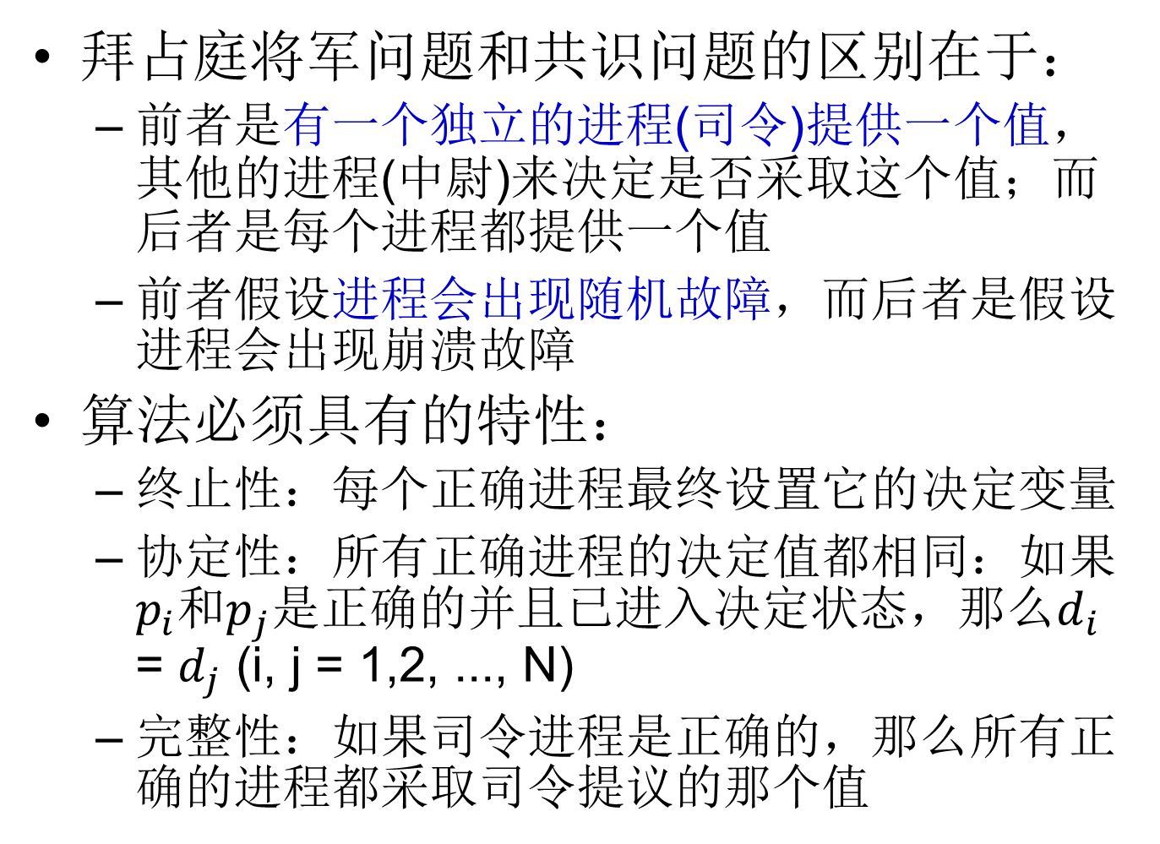
拜占庭将军问题(Byzantine Generals Problem)
拜占庭将军问题和共识问题的区别在于：
前者是有一个独立的进程(司令)提供一个值，其他的进程(中尉)来决定是否采取这个值；而后者是每个进程都提供一个值
前者假设进程会出现随机故障，而后者是假设进程会出现崩溃故障
算法必须具有的特性：
终止性：每个正确进程最终设置它的决定变量
协定性：所有正确进程的决定值都相同：如果$p_{i}$和$p_{j}$是正确的并且已进入决定状态，那么$d_{i}$ = $d_{j}$ (i, j = 1,2, ..., N)
完整性：如果司令进程是正确的，那么所有正确的进程都采取司令提议的那个值
Notes:
25

Slide 26
三个拜占庭将军
三个拜占庭将军如果有一个出错，就不能达成协定
N个将军，f个出错，如果N<3f，就不可能有解决方法
Notes:
26

Slide 27
四个拜占庭将军
四个拜占庭将军如果有一个出错，能达成协定
当出现左边情况时，两个正确的中尉进程在决定司令的值时达成一致：
p2决定 majority(v,u,v) = v; p4决定 majority(v,v,w) = v
在右边的情况中，司令是有错的，但是正确的3个中尉进程能达成一致：
p2 p3 和p4决定majority(v,u,w)=⊥（特殊值⊥代表没有占多数的值存在）
Notes:
27

Slide 28
Byzantine generals problem
A commanding general must send an order to his n-1 lieutenant generals such that:
IC1: All loyal lieutenants obey the same order.
IC2: If the commanding general is loyal, then every loyal lieutenant obeys the order he sends.
First, prove that the impossibility of a three-general solution that can handle a single traitor.
Then, give the proof by contradiction: No solution with fewer than 3m+1 generals can cope with m traitors.
LesLie Lamport, Robert Shostak, Marshall Pease, The Byzantine Generals Problem,
ACM Transactions on Programming Languages and Systems, Vol. 4, No. 3, July 1982
Notes:
28

Slide 29
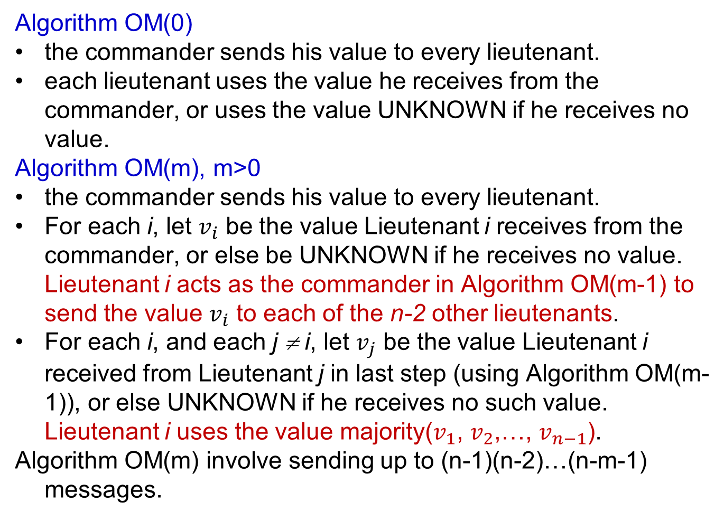
OM(m) where m is the number of traitors
Algorithm OM(0)
the commander sends his value to every lieutenant.
each lieutenant uses the value he receives from the commander, or uses the value UNKNOWN if he receives no value.
Algorithm OM(m), m>0
the commander sends his value to every lieutenant.
For each i, let $v_{i}$ be the value Lieutenant i receives from the commander, or else be UNKNOWN if he receives no value. Lieutenant i acts as the commander in Algorithm OM(m-1) to send the value $v_{i}$ to each of the n-2 other lieutenants.
For each i, and each j ≠ i, let $v_{j}$ be the value Lieutenant i received from Lieutenant j in last step (using Algorithm OM(m-1)), or else UNKNOWN if he receives no such value. Lieutenant i uses the value majority($v_{1}$, $v_{2}$,…, $v_{n−1}$).
Algorithm OM(m) involve sending up to (n-1)(n-2)…(n-m-1) messages.
Notes:
29

Slide 30
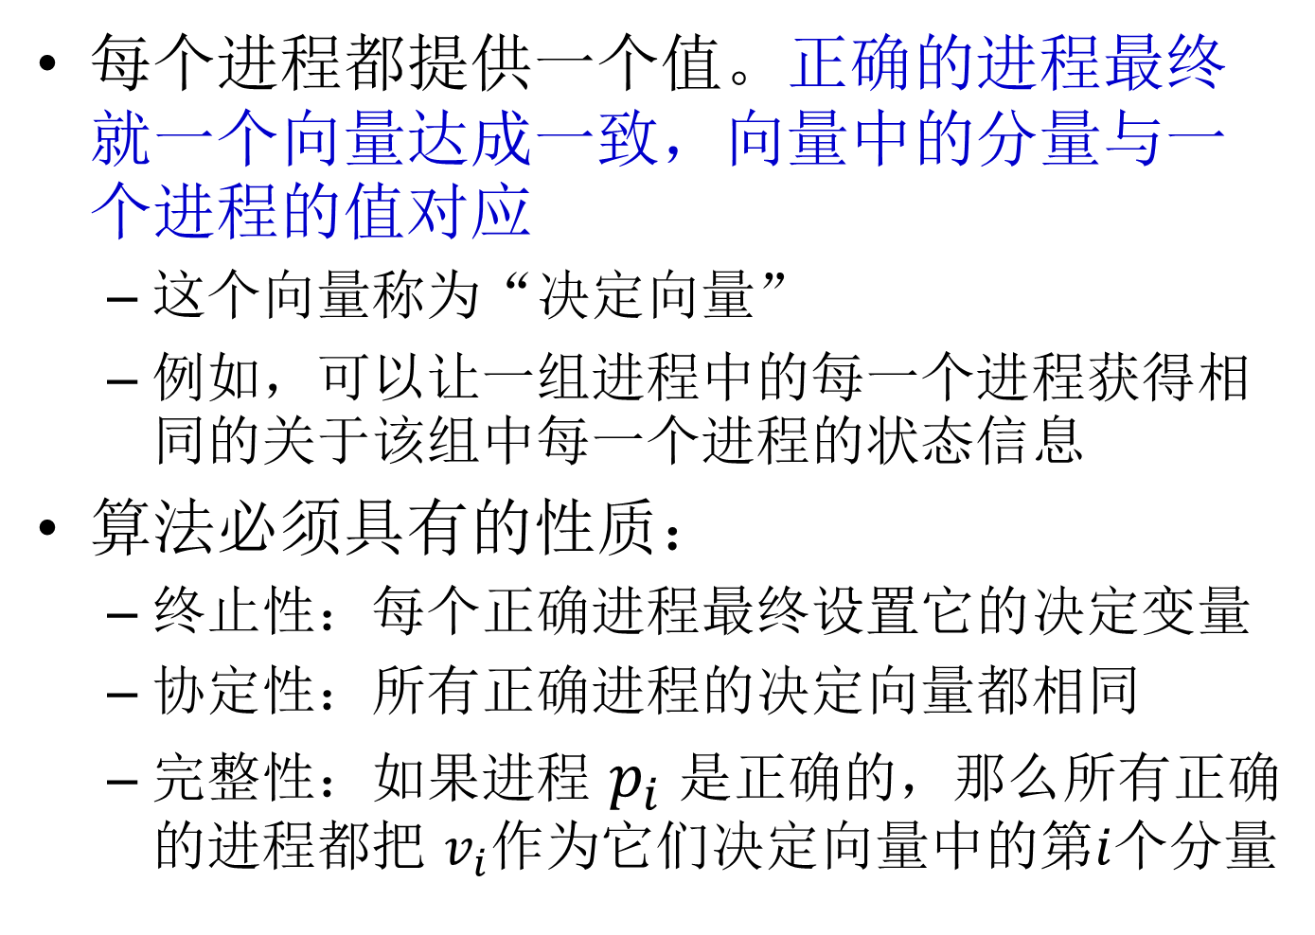
交互一致性问题(拜占庭将军问题的推广)
每个进程都提供一个值。正确的进程最终就一个向量达成一致，向量中的分量与一个进程的值对应
这个向量称为“决定向量”
例如，可以让一组进程中的每一个进程获得相同的关于该组中每一个进程的状态信息
算法必须具有的性质：
终止性：每个正确进程最终设置它的决定变量
协定性：所有正确进程的决定向量都相同
完整性：如果进程 $p_{i}$ 是正确的，那么所有正确的进程都把 $v_{i}$作为它们决定向量中的第$i$个分量
Notes:
30

Slide 31
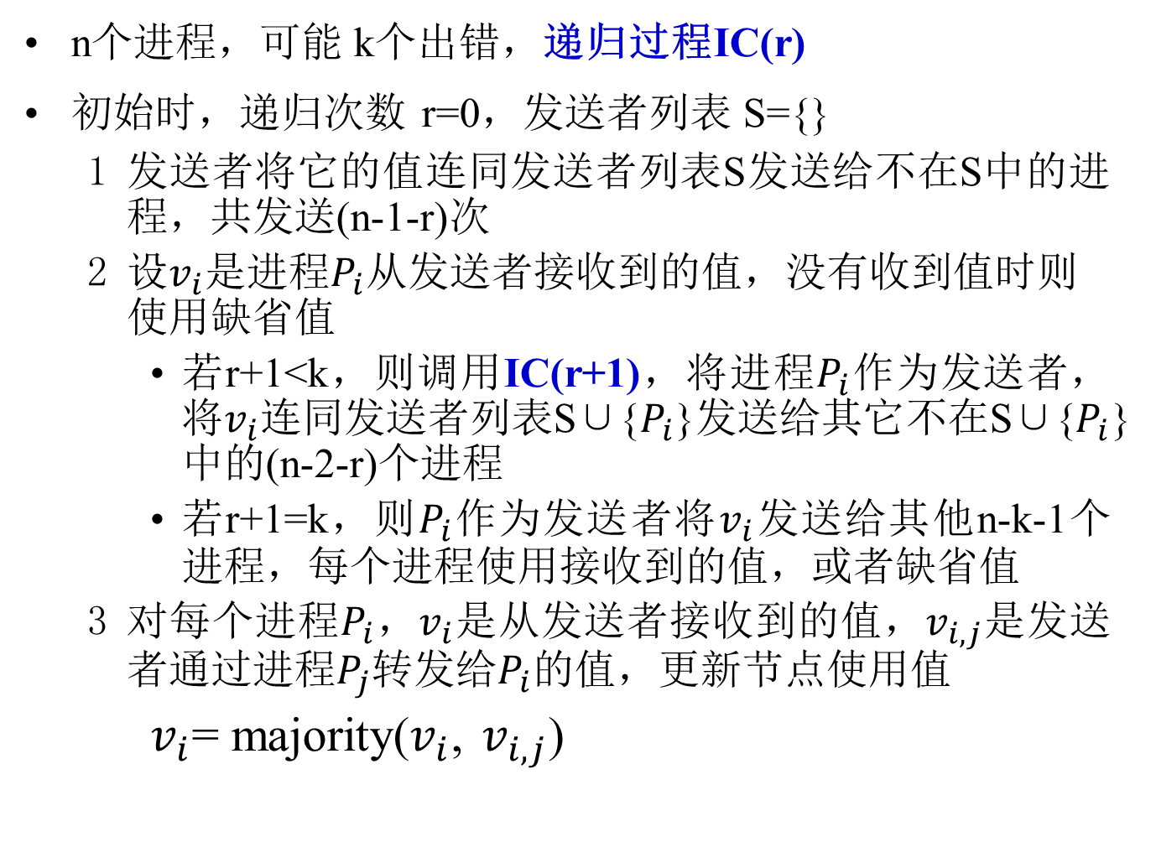
交互一致性算法
n个进程，可能 k个出错，递归过程IC(r)
初始时，递归次数 r=0，发送者列表 S={}
发送者将它的值连同发送者列表S发送给不在S中的进程，共发送(n-1-r)次
设$v_{i}$是进程$P_{i}$从发送者接收到的值，没有收到值时则使用缺省值
若r+1<k，则调用IC(r+1)，将进程$P_{i}$作为发送者，将$v_{i}$连同发送者列表S∪{$P_{i}$}发送给其它不在S∪{$P_{i}$}中的(n-2-r)个进程
若r+1=k，则$P_{i}$作为发送者将$v_{i}$发送给其他n-k-1个进程，每个进程使用接收到的值，或者缺省值
对每个进程$P_{i}$，$v_{i}$是从发送者接收到的值，$v_{i,j}$是发送者通过进程$P_{j}$转发给$P_{i}$的值，更新节点使用值
$v_{i}$= majority($v_{i}$, $v_{i,j}$)
Notes:
31

Slide 32

Generalized Byzantine Generals Problem (1)
第1轮:1收到 (1:1, 2:2, 3:x, 4:4)
第2轮:1收到2传来的记录(2:1:1,2:2,2:3:y,2:4:4)
1收到3传来的记录(3:1:a,3:2:b,3:3:c,3:4:d)
1收到4传来的记录(4:1:1,4:2:2,4:3:z,4:4:4)
所以,在1能达成协定(1,2,unknown,4)
The Byzantine generals problem for 3 loyal generals and1 traitor.
The generals announce their troop strengths (in units of 1 kilo-soldiers).
The vectors that each general assembles based on (a)
The vectors that each general receives in step 3.
Generals 1,2and 4 all come to the agreement on (1,2,UNKNOWN,4)
Notes:
32

Slide 33
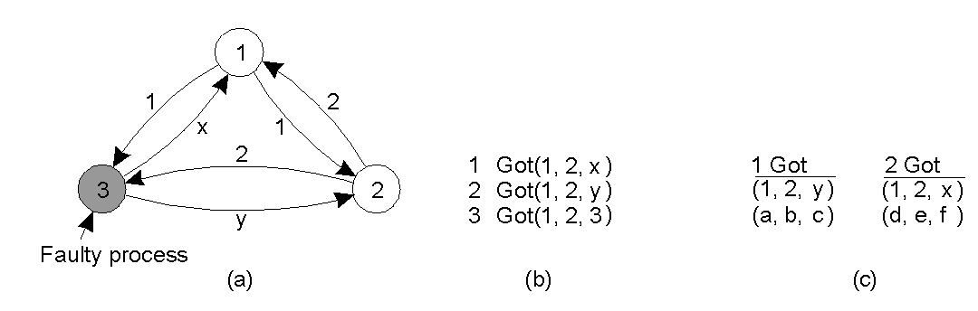
Generalized Byzantine Generals Problem (2)
The same as in previous slide, except now with 2 loyal generals and one traitor.
第1轮:1收到 (1:1,2:2,3:x)
第2轮:1收到2传来的记录(2:1:1,2:2,2:3:y)
1收到3传来的记录(3:1:a,3:2:b,3:3:c)
所以, 在1不能达成协定
Conclusion:agreement is possible only if more than two-thirds of the process are working properly.
Notes:
33

Slide 34
若干结论
在存在崩溃故障的系统中，解决共识问题等同于解决可靠且全排序组播，给定其中一个问题解决方案，就可以解决另一个问题
同步系统中的共识问题：如果要在至多f个进程崩溃的情况下仍然能够达到共识，那么，必须要进行f+1轮的信息交换
同步系统中的拜占庭将军问题：
3个进程相互之间发送(未签名)消息，如果允许一个进程出现故障，那么没有办法能够保证满足拜占庭将军问题的条件
如果总共有3f+1个进程，其中有f个进程有错(随机故障)，2f+1个进程正确，那么就能达成一致。换句话说，只有多于2/3的进程工作正常，才有可能达成协定。否则，没有解决方法
拜占庭将军、共识问题、交互一致性，从任一个的解决方案中可以构造出另外两个问题的解决方案
Notes:
34

Slide 35
异步系统的不可能性
在一个异步系统中，即使是只有一个进程出现崩溃故障，也没有算法能够保证达到共识
在异步系统中，没有可以确保的方法来解决拜占庭将军问题、交互一致性问题或者全排序可靠组播问题
绕过不可能性结论的三个方法
故障屏蔽
事务系统使用持久储存保存信息
利用故障检测器达到共识
即使是使用不可靠的故障检测器，只要通信是可靠的，崩溃的进程不超过N / 2，那么异步系统中的共识是可以解决的
随机化进程各方面的行为，使得破坏进程者不能有效地实施他们的阻碍战术
Notes:
35

Slide 36
4. Recovery

Slide 37
4 Recovery
Backward recovery: bring the system from its present erroneous state back into a previously correct state
Strength: a generally applicable mechanism
Weaknesses: relatively high cost, loop of recovery, some states can simply never be rolled back to
Examples: retransmit messages, checkpointing, message logging
Forward recovery: bring the system in a correct new state from which it can continue to execute
Weaknesses: know in advance which errors may occur.
Examples: erasure correction, stabilizing algorithms
Notes:
37

Slide 38
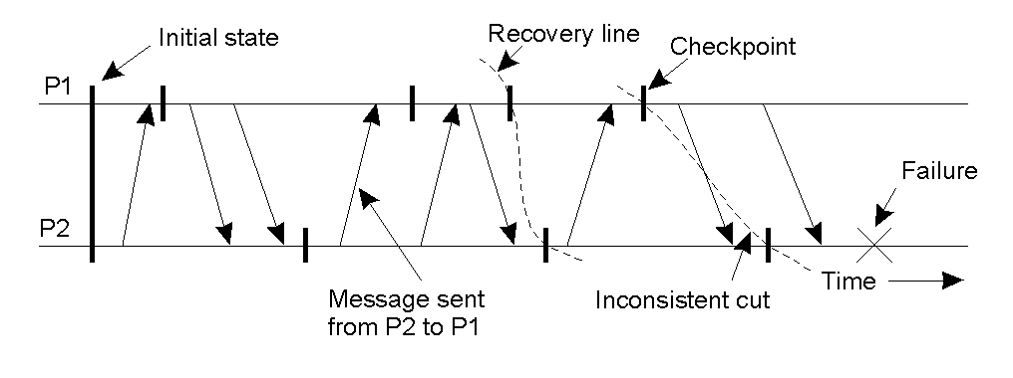
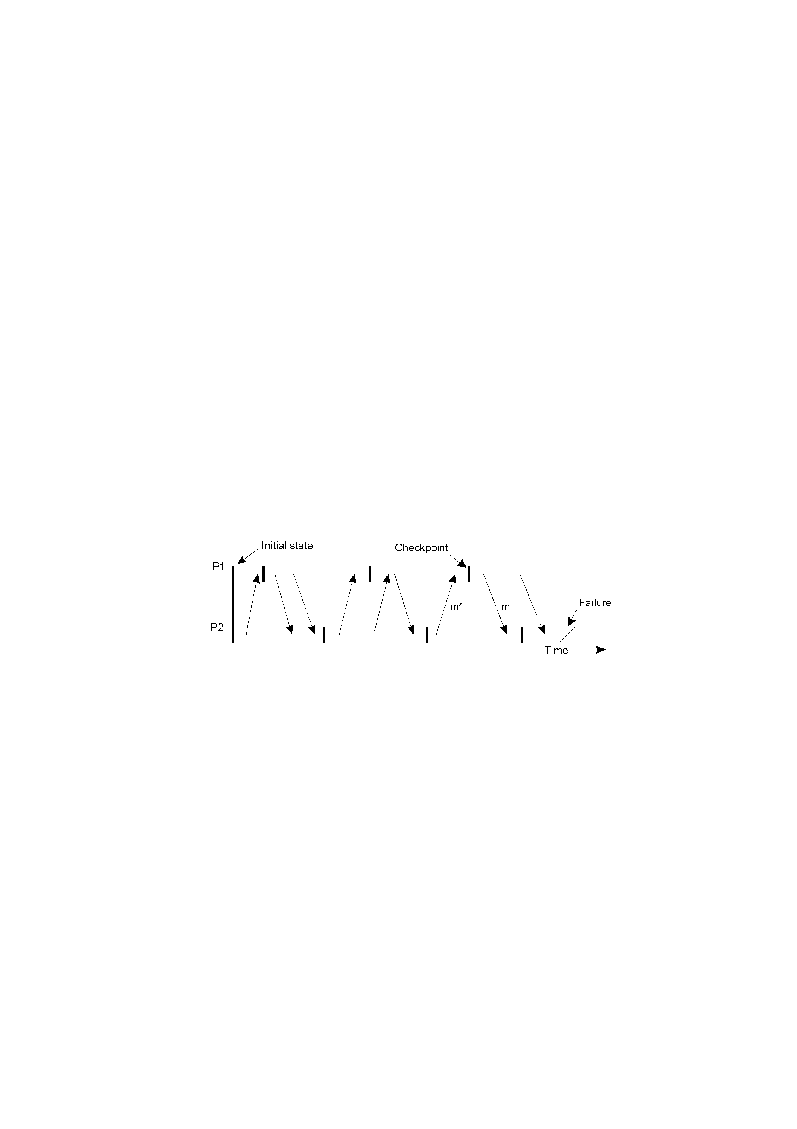
Checkpointing
A recovery line
An orphan message and the domino effect.
Notes:
38

Slide 39
Checkpointing Algorithms
Depending on the moment and frequency of checkpointing and amount of information saved in a checkpoint, there are different types of checkpoint algorithms.
Synchronous checkpointing, i.e., coordinated checkpointing, all processes synchronize to jointly write their states to local stable storage.
Asynchronous checkpointing: independent checkpointing at each process.
Uncoordinated: a completely independent action.
Notes:
39

Slide 40
Coordinated Checkpointing-I
Use a two-phase blocking protocol: a coordinator multicasts checkpoint_request, processes do local checkpoints, queue any subsequent message handed to them by the application they are executing and then send acknowledges to the coordinator, the coordinator multicasts checkpoint_done
Use a non-blocking method
Distributed snapshot algorithm (such as Chandy-Lamport’s algorithm) can be used to coordinate checkpointing
Notes:
40

Slide 41
Coordinated Checkpointing-II
Incremental snapshot:
in the two-phase blocking protocol, the coordinator multicasts checkpoint_request to those processes that depend on the recovery of the coordinator, that is, the coordinator multicasts a checkpoint request only to those processes it had sent a message to since it last took a checkpoint.
when a process P receives such a request, it forwards it to all those processes to which P itself had sent a message since the last checkpoint, and so on.
P2依赖P1
P4依赖P2

Slide 42
Independent Checkpointing-I
CP[i](m)：进程Pi做的第m次检查点
INT[i](m)：在CP[i](m-1)和CP[i](m)之间的时间间隔
Pi记录：INT[i](m)期间Pi发消息给哪个进程
Pj记录：时间间隔的依赖关系INT[j](n) → INT[i](m)
Pi要回退到CP[i](m-1)：要保证在INT[i](m)中，从Pi接收到
消息的进程，要回滚到接收到消息之前的那个检查点状态，故Pj回退到CP[j](n-1)
Pi
Pj
Notes:
42

Slide 43
Independent Checkpointing-II
After a failure, the failed process Q recovers by restoring its most recent checkpoint
If Q does not send out any message after its most recent checkpoint, recovery is completed
If Q sends out a message m to a process P, then message m has been received by P but not been sent by Q (after Q restores its checkpoint). This is inconsistent. So Q has to send a message to all processes it has sent a message, and ask them to roll back.
When P is requested to roll back, it rolls back by restoring to its most recent checkpoint.
If P has sent out messages to other processes, those other affected processes must roll back as well.
Domino effect is hard to avoid.
Notes:
43

Slide 44
Logging Messages for Replaying
When Q recovers from crash, it restores its most recent checkpoint, and re-executes its program, replaying the log (reading messages received from the log)
Under the assumption of a piecewise deterministic model: the execution of the process is deterministic after the receipt of a message (e.g., no clock or random number is used in the program)

Slide 45
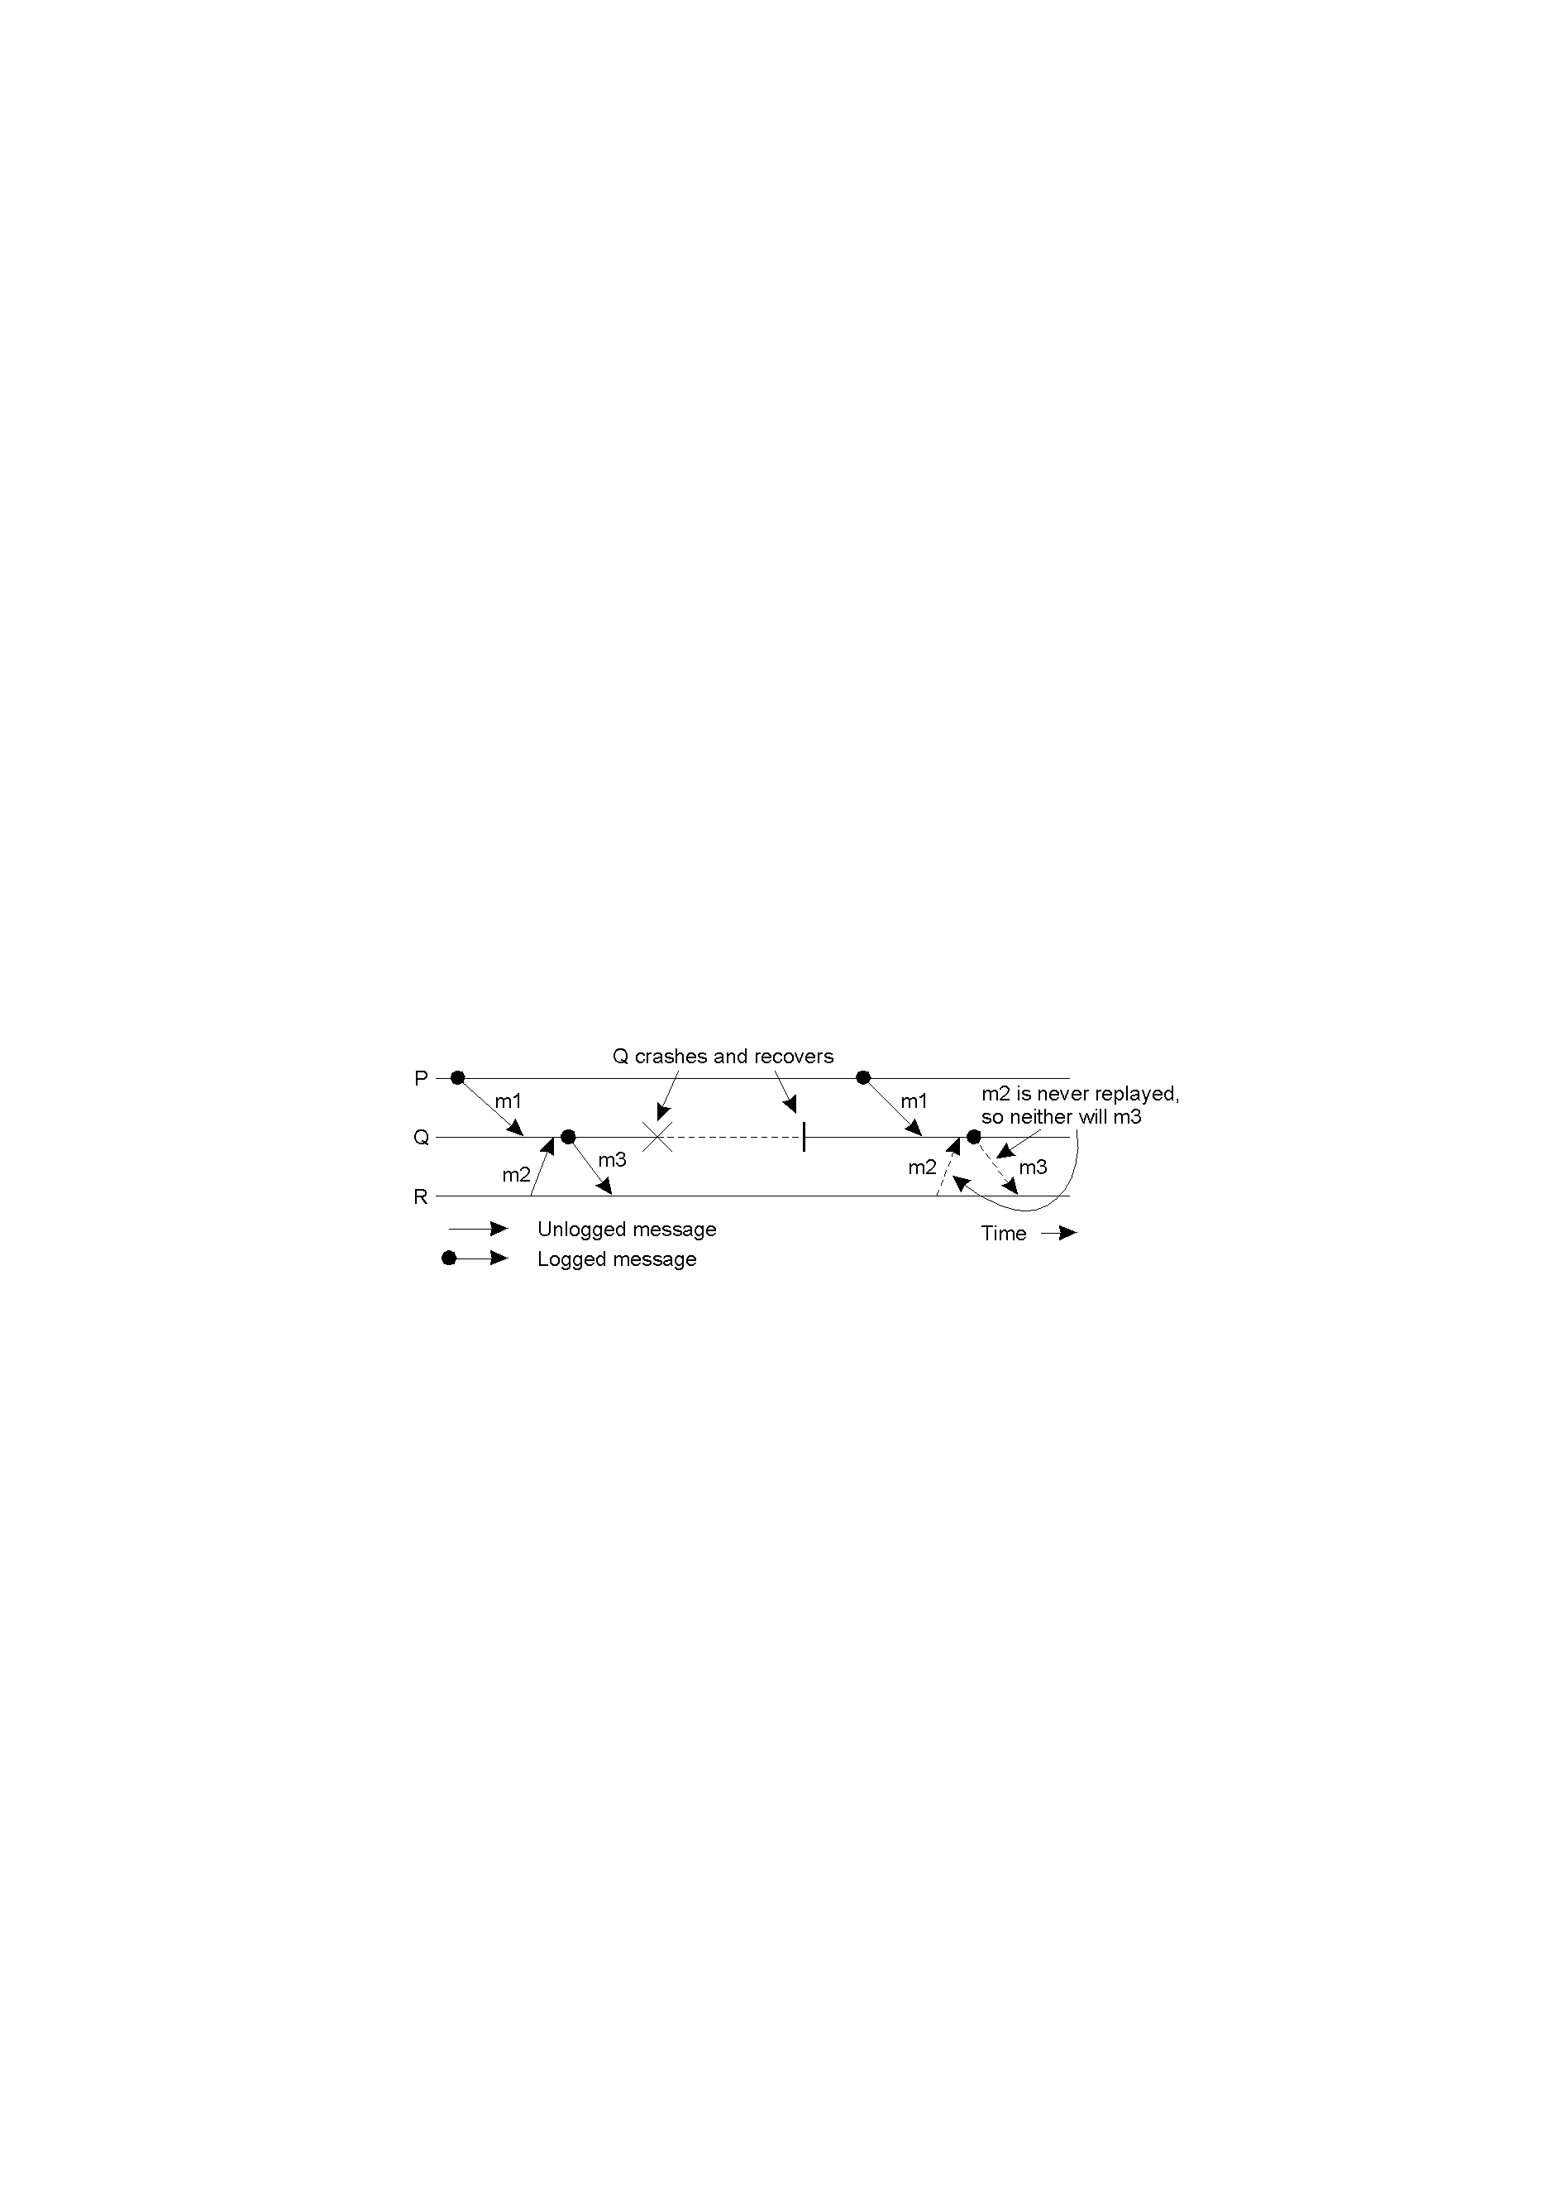
Message Logging: When messages are to be logged
Orphan process: a process that survives the crash of another process, but whose state is inconsistent with the crashed process after its recovery
Process R is an orphan process if there is a message m, such that R is contained in DEP(m), while at the same time every process in COPY(m) has crashed
DEP(m): processes to which m has been delivered
COPY(m): process that could hand over a copy of m that can be used to replay the transmission of m.
Incorrect replay of messages after recovery, leading to an orphan process R.
Notes:
45
在接收端记录消息
若Copy(m)都crash，则Dep(m)成孤儿

Slide 46
Message Logging : When messages are to be logged
Pessimistic message logging: messages are saved before processing
Optimistic message logging: independent messages saving / processing
Pessimistic logging protocols
To avoid orphan processes, whenever a process becomes dependent on the delivery of m, it will keep a copy of m.
Pessimistic logging protocols: Q is not allowed to send any messages after the delivery of m without first having ensured that m has been written to stable storage.
When Q recovers, it restores its most recent checkpoint, and re-executes its program, replaying the log.
No domino effect is possible in pessimistic message logging.
Notes:
46

Slide 47
Message Logging: Optimistic logging protocols
Optimistic message logging:
Message logging is asynchronous with respect to processing
Reason is that logging messages before processing cause a long delay due to disk I/O.
Frequency of logging messages displays a spectrum:
Logging a message whenever it is received will approximate pessimistic message logging
Batching messages and logging them just before a checkpoint is like without message logging
An unlogged message m received by a failed process P may cause P unable to recover. This makes all messages sent by P after receiving m orphans at other processes. How can P know that it has sent messages after m? P needs to keep track of the processes which depend on m. These processes have to roll back. Any orphan process dependent on m is rolled back to a state in which it no longer dependent on m
Domino effect is possible, but is restricted.
Notes:
47
P crash，P未记录m，则Dep(m)成孤儿，所以，要记录哪些进程依赖m

Slide 48
How to judge a consistent global state (1)
Recall the definition of a consistent global state: a collection of local states, one from each process, such that no message is received but has not been sent in the global state (no orphan message)
We may apply the vector clock concept to the recovery model. For a system of n processes, each event is associated with a vector clock of size n.
稍带传(0,1,0)
捎带传(1,0,0)
Notes:
48

Slide 49
How to judge a consistent global state (2)
Denote S1 by matrix, called the dependency matrix, same for S2.
Each row of the matrix is formed by vector clock of local state of a process constituting the global state.
Thus D(S1) = and D(S2) =
Rule: state S is consistent if and only if all diagonal elements dominate the columns.
Notes:
49

Slide 50
How to judge a consistent global state (3)
Diagonal of the matrix counts the number of events each process has executed, up to global state S.
A state is consistent if the process knows the best about itself than other processes.
In the example:
You can verify that the diagonal in D(S1) dominates the columns, i.e., diagonal is the largest element along each column.
This means that S1 is consistent.
For state S2, it can be seen that the diagonal no longer dominates the columns.
The largest element of first column is not on the diagonal.
Thus S2 is inconsistent. Reason: P3 knows of 5 events from P1, but P1 only executes 2.
Notes:
50

Slide 51
State Interval Model for Recovery (1)
Assuming the deterministic process execution and message logging, the vector clock can be modified for state intervals instead of for events.
State interval
A state interval is a sequence of events on a process.
A state interval is started by receipt of a message.
Each state interval has a sequence number, called the state interval index.
A state interval ends when a new message is received, including the receiving event of current message but excluding the new message.
Each message carries the state interval index and each state interval is associated with a dependency vector C, which is like a vector clock for an event.
Notes:
51

Slide 52
State Interval Model for Recovery (2)
state
interval
index
When a message from Pj is received at Pi, Ci[j] will be incremented by 1.
S1 and S2 can be denoted by the dependency matrices.
Thus D(S1)= and D(S2)=
The diagonal of the matrix counts the number of messages each process has received, up to the global state.
0
1
2
稍带传P2的状态0
0
1
2
0
1
2
Notes:
52

Slide 53
State Interval Model for Recovery (3)
In D(S1), the diagonal dominates the columns, meaning that S1 is consistent, or will be consistent on deterministic recovery.
In D(S2), the diagonal no longer dominates the columns. Thus S2 is not consistent, and there is an orphan message.
The diagonal corresponds to a global state.
Since only receiving events are relevant, some global states are considered identical in this model.
A global state in which the diagonal dominates the columns is called a consistent global state.
Notes:
53

Slide 54
State Interval Model for Recovery (4)
In optimistic message logging, messages are logged asynchronously with respect to processing, and checkpoints are taken occasionally.
A state interval is stable if all messages received between its most recent checkpoint and its starting message are logged.
It is easy to see that a stable state interval can be reproduced from the disk when the process recovers after crashing (by restoring the most recent checkpoint and replaying messages from the log).
A global state is recoverable if all state intervals in the state are stable.
It is required that upon recovery after a failure, a consistent recoverable global state is restored.
State interval model optimizes in reducing message overhead from a vector to a single number, and the size of counter.
It also provides a basis for processes to detect orphan messages and to perform appropriate rollback recovery.
Notes:
54

Slide 55
Forward error recovery: Stabilization
The set of all possible configurations or behaviors of a distributed system can be divided into two classes: legal, illegal.
The legal configuration of a nonreactive system is usually represented by an invariant over the global state of the system.
In reactive systems, legal configuration is determined not only by a state predicate, but also by behaviors.
Well-behaved systems are always in a legal configuration, but such a system may switch to an illegal configuration due to the following reasons: transient failures, topology changes, environmental changes.
A system is called stabilizing when the following two conditions hold:
Convergence: regardless of the initial state, and regardless of eligible actions chosen for execution at each step, the system eventually returns to a legal configuration.
Closure. Once in a legal configuration, the system continues to be in the legal configuration unless a failure or a perturbation corrupts the data memory.
Notes:
55

Slide 56
A stabilizing algorithm for constructing a spanning tree
Assume that failures do not partition the network and now construct from a connected undirected graph G=(V, E) (where |V| = n) a spanning tree rooted at r with each node knowing its level in the tree.
Each node i other than the root r maintains the two local variables: L(i): level of i; P(i): parent of i. The root node r has L(i) =0 and no parent variable.
Legal state: if the parent pointers constitute a spanning tree of G rooted at the root, an each node except the root has a level equal to the level of its parent plus one.
If the following predicate is true, then the system reaches a legal state:
GST ≡ (∀i,p: i≠r ∧ p =P(i): L(i)=L(p)+1)
Notes:
56

Slide 57
A stabilizing algorithm
(R0) L(i) ≠ n ∧ L(i) ≠ L(p) +1 ∧ L(p)≠n → L(i) := L(p) +1
(R1) L(i) ≠ n ∧ L(p) = n → L(i):=n
(R2) let k be some neighbor of i, L(i) = n ∧ L(k)<n-1 →L(i):=L(k)+1; P(i) :=k
C
0
0
C
0
C
0
C
R2
R1
R2
R2
R2
R2
2
B
D
5
2
B
D
5
5
B
D
5
1
B
D
5
3
E
A
1
3
E
A
3
E
A
5
3
E
A
5
5
R2
R1
R1
R2
R0
R2
0
C
0
C
0
C
1
B
D
2
1
B
D
2
1
B
D
2
3
E
A
5
2
A
E
5
2
E
A
3
R0
R2
R2
Notes:
57

Slide 58
Define an edge from i to P(i) to be well formed, when L(i) ≠ n ∧ L(p(i))≠n ∧ L(i) = L(p(i)) +1.
In any configuration, the nodes and well-formed edges form a spanning forest.
Delete all edges that are not well formed, and designate each tree in the forest by T(k) where k is the smallest value of a node in the tree.
A single node with no well-formed edge incident on it represents a degenerate tree.
Define a tuple F=(F(0),F(1),F(2), …, F(n)) such that F(k) is the count of T(k)’s in the spanning forest.
C
0
R2
2
B
D
5
3
E
A
1
R1
T(0) = {C}
T(1) = {A,B,E}
T(5) = {D}
F=(1,1,0,0,0,1)
0
C
R2
1
B
D
5
3
E
A
5
R2
T(0)={C,B}
T(3)={E}, T(5)={A}
T(5)={D}
F=(1,0,0,1,0,2)
Notes:
58

Slide 59
A lexicographic order(>) on F is defined as follows:
F₁>F₂ ➔ ∃j>0: ∀i < j: F₁(i) =F₂(i) ∧ F₁(j) >F₂(j).
With n nodes, the maximum value of F is (1, n-1, 0,…,0) and the minimum value is (1,0,0,…,0) that represents a single spanning tree rooted at 0.
F is the bounded function whose value decreases for each move
F monotonically decreases each time when rule (R0),(R1) or (R2) is applied.
R0：F(i) 减少，F(j) (j<i) 不减少
R1：F(n)增加，F(i)减少，F(j) (j<i) 不受影响
R2：F(n)下降，其他F不受影响
Chen, Nian Shing; Yu, Hwey Pyng; Huang, Shing Tsaan, A self-stabilizing algorithm for
constructing spanning trees. Inform. Process. Lett. 39 (1991), no. 3, 147–151.

Slide 60

Barbara Liskov (1939-)
美国第一个获得计算机科学博士学位的女性(1968年斯坦福大学)
美国国家工程院院士、美国艺术与科学院院士，2004 获IEEE John von Neumann Medal，2008获Turing Award，现任MIT教授
编程语言和系统设计方面尤其是数据抽象、容错和分布式计算方面的贡献
2种计算机语言：CLU(一种支持数据抽象的面向对象编程语言)和Argus(一种分布式程序实现的高级语言),提出了面向对象设计中的Liskov替换原则(LSP)
小型、低成本、交互式的分时操作系统Venus，面向对象数据库系统Thor，Byzantine分布式容错系统
Abstraction and Specification in Program Development // Program Development in Java: Abstraction, Specification, and Object-oriented Design

Slide 61
Barbara微软亚洲研究院访谈
我并没有规定自己一定要达到什么程度，我只是在我可及的范围内工作
一个人能否成功，找到自己的所爱和所长是非常必要的
持续的学习和探索，一定会让人发现自己的强项在哪里，关键在于不要放弃这种寻找和尝试
自信从何而来？它源自于阅历的持久积淀
研究者要做的，是选择最佳的解决方案，同时要充分论证为什么这种方案是最理想的

